Slide 1
Calcul de la Taille de l’Echantillon
Notes:
In this part of this lecture we will talk about how to calculate sample size.

Slide 2
Étapes pour Calculer la Taille de l’Echantillon pour une Étude Descriptive
Déterminer la variable majeure de l’étude
Déterminer le type d’estimation
Déterminer l’amplitude de l’estimation attendue
Choisir la précision de l’estimation désirée
Choisir le niveau de confiance désiré
Adapter en fonction du taux de réponse attendu
Notes:
To calculate the sample size for a descriptive survey, there are several steps you must follow.
First, you will need to identify the major study variable that corresponds to the outcome of interest. Next, you need to determine the type of estimate you will be calculating (whether it be a proportion or a mean value of a continuous variable). Then, you need to determine the expected magnitude of the estimate, and choose the desired precision and confidence level. At this point, you can calculate the sample size, which you will then adjust for the expected response rate.

Slide 3
Études Transversales: Taille de l’Echantillon pour la Prévalence
Pour des échantillons aléatoires simples, systématiques et stratifiés
n = taille de l’échantillon
z = niveau de confiance
p = proportion (prévalence)
q = 1 – p
d = précision
Notes:
Here is the formula for calculating the sample size for a descriptive étude transversale in which you are estimating prevalence. This formula also applies to any study estimating a proportion. This formula is used for studies utilizing simple random sampling, systematic random sampling, or stratified random sampling. (Studies using cluster sampling must adjust for the design effect, but that is beyond the scope of this lecture.)
The sample size is denoted by the letter “n”. The confidence level corresponds to the letter “z”, “p” stands for the prevalence, “q” is equal to 1 minus “p”, and “d” is equal to the precision.

Slide 4
Composantes de la Formule de Taille de l’Echantillon
z = niveaux de confiance
90 % de confiance, z = 1,65
95 % de confiance, z = 1,96
99 % de confiance, z = 2,58
p = la prévalence estimée
Si la prévalence estimée est inconnue, l’estimation la plus prudente sera d’établir cette valeur à 0,50
q = 1 moins la prévalence estimée
d = précision, établie par l’enquêteur (souvent à 0,05 ou 0,10)
Notes:
Let’s review what the different components in the sample size formula for prevalence.
‘z’ represents the confidence level, which is calculated using a z-score (which we discussed earlier in the presentation). The z-scores for the most common confidence levels used are 1.65 for a 90% confidence level, 1.96 for a 95% confidence level, and 2.58 for a 99% confidence level.
‘p’ equals the estimated prevalence, for example, we may estimate a prevalence of 15% based on similar studies done in other countries. If you don’t have an estimate of the prevalence (perhaps you are studying a new disease, or no previous studies have been published on your outcome of interest), then choosing an estimated prevalence of 50% will provide the most conservative estimate for sample size.
‘q’ is equal to one minus the estimated prevalence, for example if we take one minus our estimated prevalence of 15% then ‘q’ would be equal to 0.85.
‘d’ represents the precision, it is something that is set by the investigator, often at 5% or 10%. Larger values for precision will result in smaller sample sizes, but this will also result in a less precise estimate of prevalence.

Slide 5
Études Transversales: Taille de l’Echantillon Ajustée
Si n > 10 % de la taille de la population totale, alors :
n_{a} = taille de l’échantillon adaptée
n = taille initiale de l’échantillon
N = taille de la population totale
Notes:
If the estimated sample size is greater than 10% of the total population size, which may occur when the total population size is small, then the sample size needs to be adjusted. The formula for this adjustment is shown on this slide. “n_{a}” is the adjusted sample size, “n” is the initial sample size calculated using the first formula, and “N” is the total population size.

Slide 6
Exemple: Taille de l’Echantillon - Calcul pour la Prévalence
Étude pour estimer la prévalence des allergies au latex parmi les infirmières dans un pays X
Prévalence estimée (p) : 10 %
Précision (d) : +/- 5 %
Niveau de confiance (z) : 90 % (z-valeur = 1,65)
Notes:
Let’s work through an example sample size calculation for a study which will be conducted to estimate the prevalence of latex allergies among nurses in county X.
You estimate the prevalence of latex allergies to be 10% based on estimates from other studies in nurses. You choose a precision of 5% and a confidence level of 90%, which corresponds to a z-value of 1.65.
Instructor, ask the class to calculate the sample size on their own using a calculator. After a few minutes ask the students to give their answer. Then click to show the completed calculation.

Slide 7
Ajustement pour un Taux de Réponse Prévu
Tous les sujets sélectionnés n’acceptent pas nécessairement de participer à l’étude
Nécessité d’augmenter la taille de l’échantillon pour tenir compte des non-réponses
Multiplier le taux de non-réponses prévu par la taille de l’échantillon, ajouter ce chiffre à la taille de l’échantillon pour obtenir la taille de l’échantillon total
Notes:
Since it is almost certain that not all subjects who are selected by your sampling method will actually agree to participate in the study, it is necessary to increase your sample size to adjust for an expected amount of non-response. To do this, you need to multiply the expected non-response rate (which will vary with the study population and methods of data collection) by the sample size, then you will add that number to the sample size to get the total sample size.

Slide 8
Exemple : Calcul de la taille de l’échantillon pour un ajustement du taux de réponse
Nombre total d’infirmières dans un pays X : 750
98/750 = 13 %
Taux de non-réponse attendu : 20 %
Notes:
We know that there are approximately 750 nurses who practice in county X. By dividing the sample size by the total population size we get 13%. Since this number is greater than 10% we need to perform the population adjustment.
Instructor, ask the class to calculate the adjusted sample size on their own using a calculator. After a few minutes ask the students to give their answer. Then click to show the completed calculation.
Finally, we also need to account for the expected non-response rate, which we estimate to be 20%.
Instructor, ask the students to calculate the final sample size after adjusting for the non-response rate. After a few minutes ask the students to give their answer. Then click to show the completed calculation.

Slide 9
Introduction à OpenEpi
Notes:
Before we move on to using statistical software to calculate sample size, first I’d like to spend a few minutes introducing you to a useful software program called OpenEpi.

Slide 10
Quand Utiliser OpenEpi
Lorsque seules les données sommaires sont disponibles
Impossibilité d’importer les ensembles de données réelles
Possibilité d’entrer les comptes seulement
Sert à :
Calculer les mesures de fréquence de la maladie
Calculer les mesures d’association
Effectuer des tests statistiques de base
Calculer la puissance ou la taille de l’échantillon
Générer des numéros aléatoires
Notes:
OpenEpi is a web-based software that is free and open to the public and can perform many of the basic calculations used in epidemiology. OpenEpi is different than Epi Info in that it does not use actual datasets, but performs calculations based on summary data that you enter into the program. You must have summary counts to use OpenEpi.
There are five major functions of OpenEpi, it can be used to calculate measures of disease frequency, measures of association, basic statistical tests, calculate power and sample size, and generate random numbers. Now let us take a look at how to use OpenEpi.

Slide 11
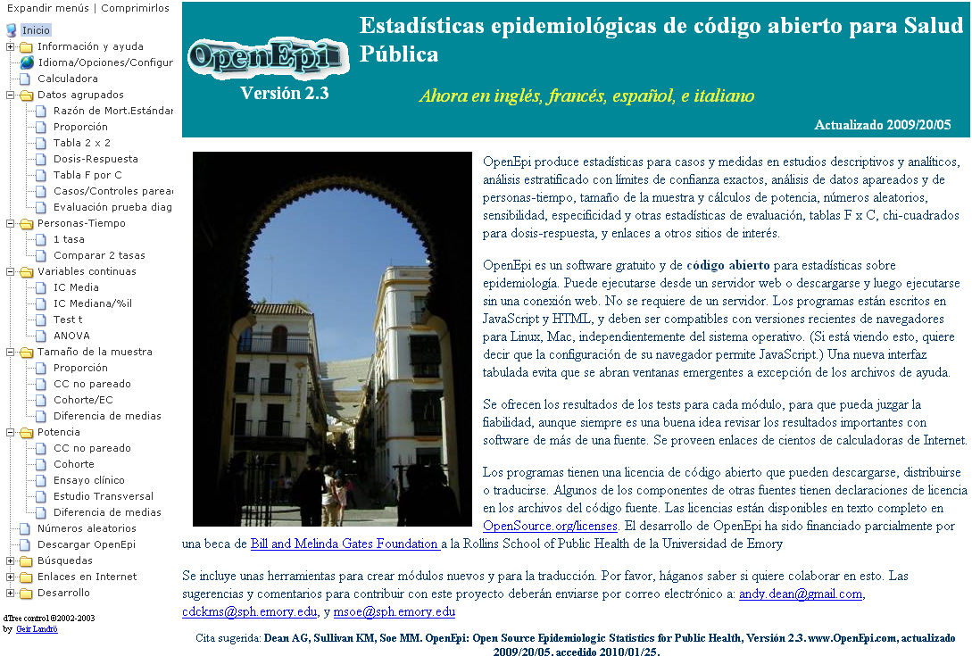
Page d’Accueil d’OpenEpi
Aller à : http://www.openepi.com/Menu/OpenEpiMenu.htm
Notes:
You can access OpenEpi by going to: http://www.openepi.com/Menu/OpenEpiMenu.htm
Here is a view of the OpenEpi homepage. Here you can find some background information about the program and who developed it. There is also a downloadable version of the software, but we will be using the web-based version in this session. Feel free to follow along on your own laptop as we walk through the examples.

Slide 12
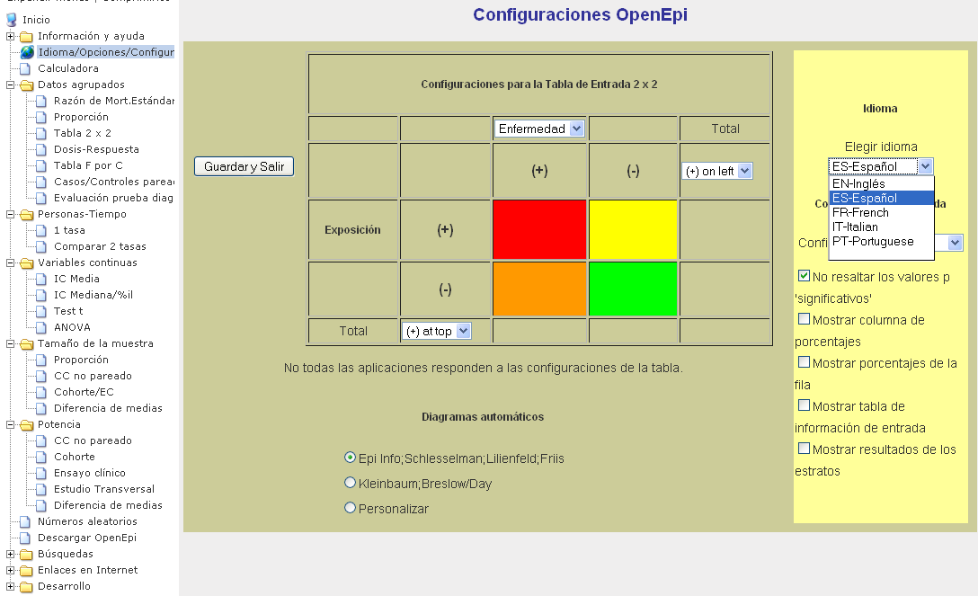
Choix de la Langue dans OpenEpi
Notes:
First, you may need to change the language settings of the program.
(Click to show arrow)
You can do this by clicking on “Idioma/Opciones”
(Click to show second arrow)
Then choose your preferred language from the drop down menu.

Slide 13
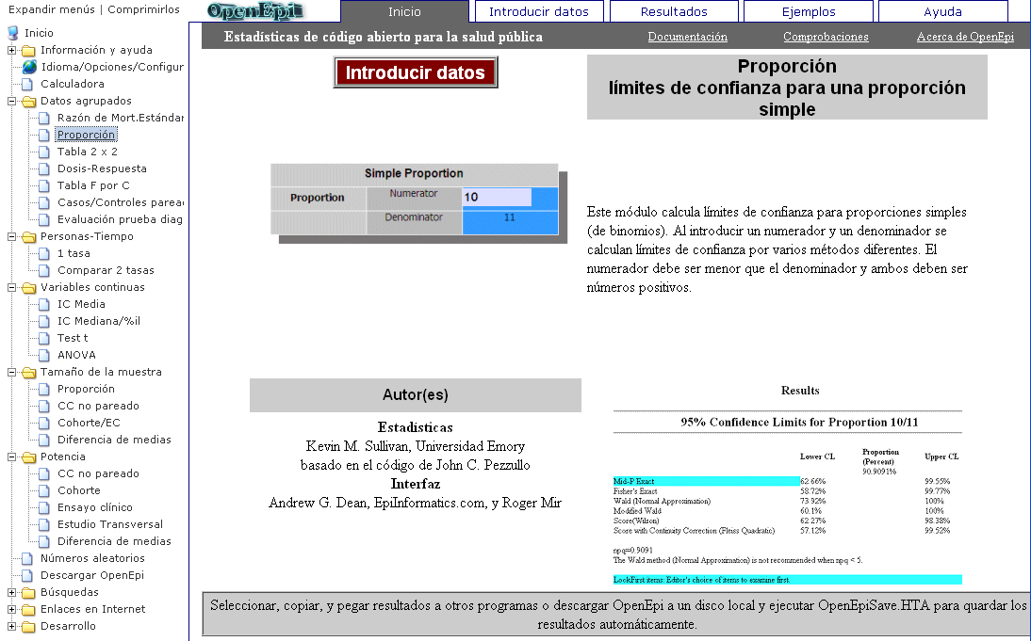
Menu OpenEpi
Onglets de fonctions
Arbre de commandes
Notes:
There are two different parts of OpenEpi that will be important for you to be familiar with in order to use the program.
The first is the command tree, which is located on the left side of the screen. This is similar to the command tree used in Epi Info. The different commands are broken down into groups by data type and function, including: “Datos agrupados”, “Personas-tiempo”, “Variables continuas”, “Tamano de la muestra”, and “Potencia”.
Across the top of the screen you will see five tabs, each which correspond to a different function. The “Inicio” tab provides an intorduction and overview of the selected command, the “Introducir datos” tab is where you go to enter your data, and the “Resultados” tab is where you will find the results of the calculations you requested.

Slide 14
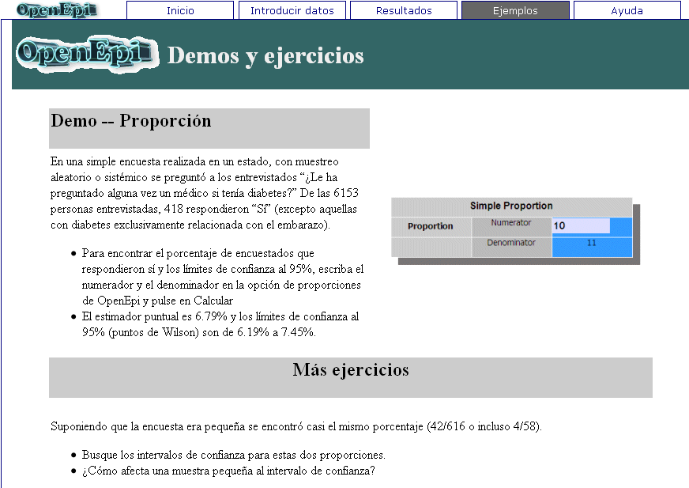
Onglet des Exemples
Notes:
If you want to practice using a command, or want to see an example, then you can click on the “Ejemplos” tab within the command you are interested in.

Slide 15
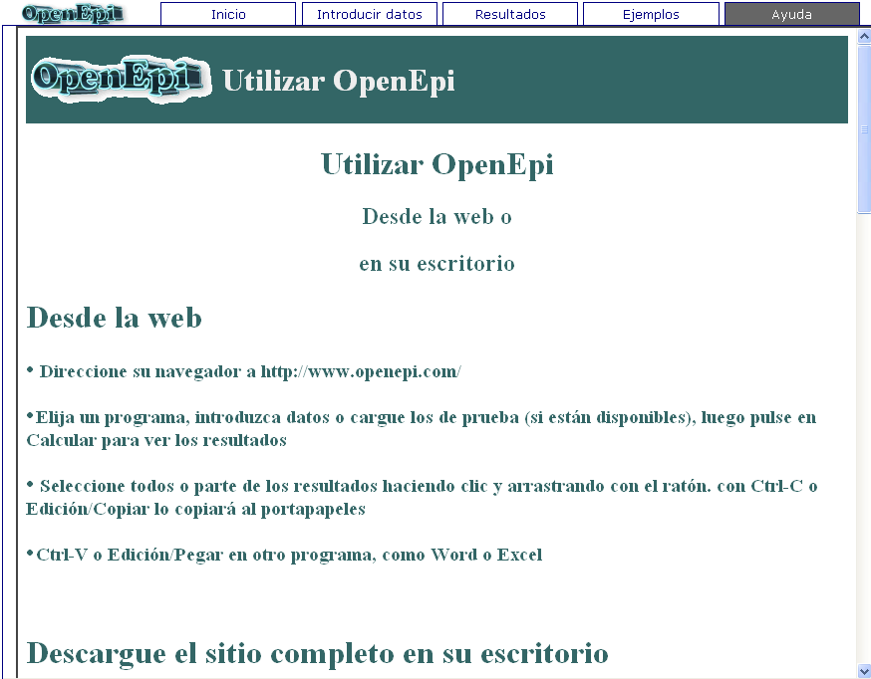
Onglet de l’Aide
Notes:
Finally, the “Ayuda” tab is the place to go if you are looking for some basic instructions for how to use the program.

Slide 16
Générer des Nombres Aléatoires dans OpenEpi
Notes:
Let’s look at how we can generate random numbers in OpenEpi to use in the sampling methods we have discussed today.

Slide 17
Sélection de Sujets en Utilisant des Nombres Aléatoires dans OpenEpi
Comment le faire :
Entrer la gamme (x à y)
Entrer la taille de l’échantillon (n)
OpenEpi générera des nombres aléatoires « n » entre x et y
Sélectionner les sujets correspondant aux numéros sélectionnés pour votre échantillon
Ce dont vous avez besoin :
Taille de la population totale
Taille de l’échantillon (n)
Liste numérotée des unités dans la population (les numéros doivent être séquentiels, de x à y)
Notes:
In order to select subjects using the random number generator in OpenEpi, you will need:
The total population size that you will be sampling from
Your desired sample size (n)
And a numbered list of the units in the population, these numbers should be sequential (we will denote this list as numbers from x to y).
To randomly select your subjects, you will need to input the range (x to y) and the sample size (n) into OpenEpi (we’ll look at an example on the next slide). OpenEpi will then generate ‘n’ random numbers between x and y. It is then your job to take that list of random numbers and select the subjects which correspond to those numbers for inclusion in your sample.

Slide 18
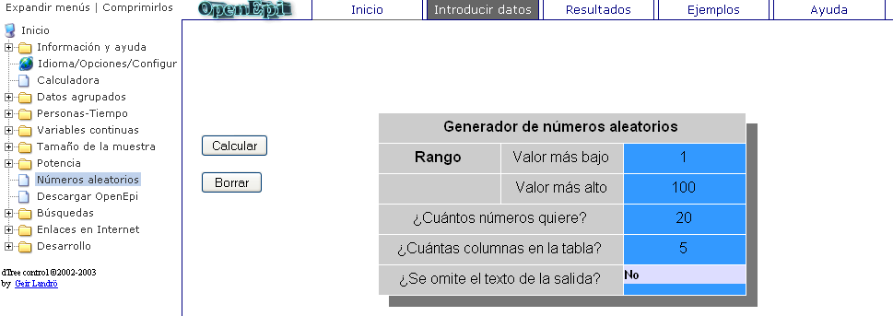
Entrée de l’Echantillon : OpenEpi Générateur de Nombres Aléatoires
Notes:
Note to instructor: Click to show arrow.
To use the random number generator in OpenEpi, select the “Numeros aleatorios” command from the command tree.
Here is what the parameter input screen looks like for the OpenEpi random number generator. In this example, we want to select a sample of 20 people from a population of 100. We have a list of people in the population, with each person assigned a number from 1 to 100, so we enter these values in the top two boxes. Then we enter the sample size (20). By default, OpenEpi suggests putting the numbers in 5 columns and not omitting text from the output, which are the options we will use in this example. To get the output, click “Calcular”.

Slide 19
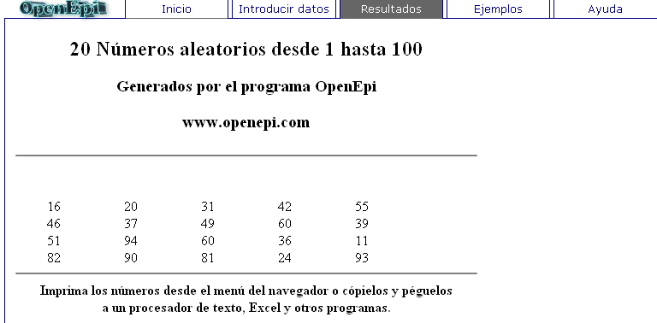
Sortie de l’Echantillon : OpenEpi Générateur de Nombres Aléatoires
Notes:
Here is the output from our example. We see a list of 20 numbers between 1 and 100 that were randomly selected by the software. Now we can go back to the original list of the population members and select those who match the numbers in this table.

Slide 20
Calcul de la Taille de l’Echantillon dans OpenEpi et Epi Info
Notes:
In the last part of this lecture I will demonstrate how to use OpenEpi and Epi Info to conduct random sampling and calculate sample size.

Slide 21
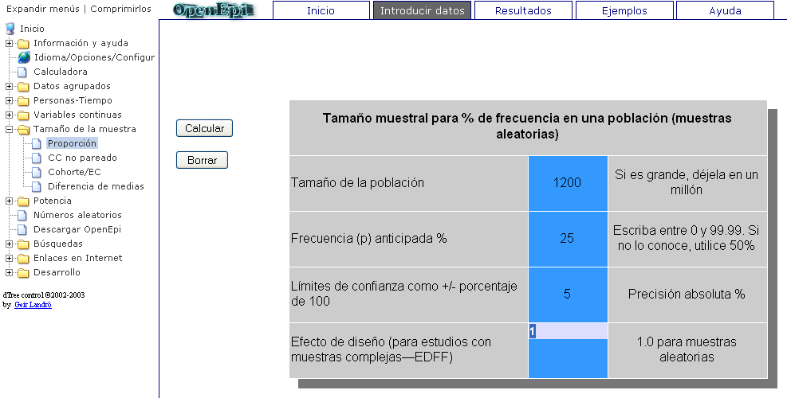
Taille de l’Echantillon pour la Prévalence : OpenEpi
Notes:
To calculate the sample size for a prevalence study in OpenEpi, choose the “Proporcion” option under the “Tamano de muestra” option in the command tree. Let’s use the tooth decay study example we discussed earlier to practice calculating sample size in OpenEpi.
First we enter the size of the total population (“N” from our formula), which is 1200 for this example
Then enter the estimated frequency (prevalence), (“p” from our formula), which we estimate to be 25% based on national averages from other countries
Next enter the precision (“d” from our formula), which we will set at 5%
We can leave the design effect as 1.0 as long as we used a random sampling method (the design effect is used for cluster sampling or other complex sampling methods)
Go ahead and enter these numbers yourself if you have a computer, and then click “Calcular”.

Slide 22
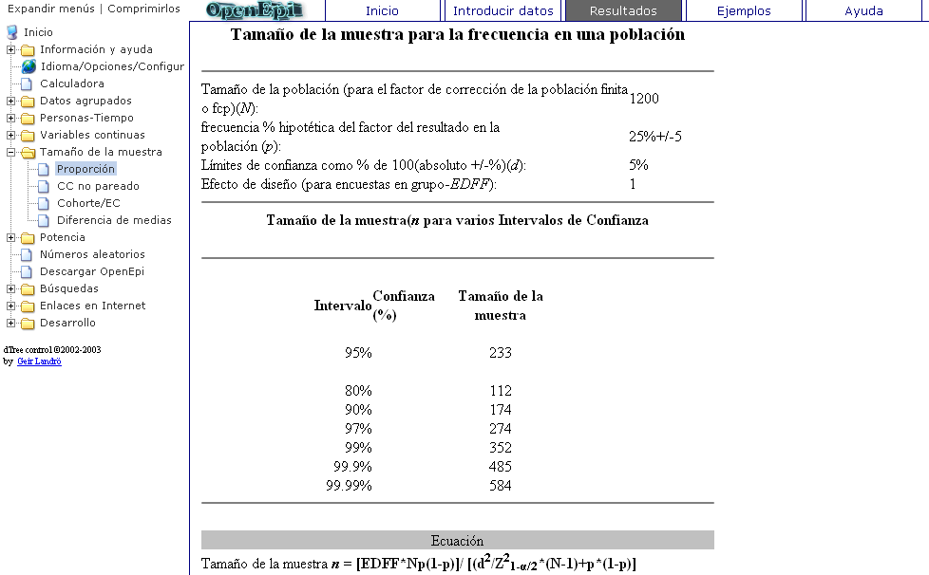
Taille de l’Echantillon pour la Prévalence : OpenEpi
Notes:
The top section of the output shows the parameters we just entered
The bottom part of the output shows the sample size estimates at different confidence levels, from 80 to 99.99%.
If we chose a 95% confidence level, then our sample size will be 233.
(Click to show box)
These calculations take into account the size of the population, but do not account for non-response. You will need to adjust the final sample size to account for anticipated non-response on your own.
Instructor, ask the students to calculate the final sample size if 10% non-response is expected.
233*0.1 = 23
233+23=256 = total sample size

